Slide 1


The PiXL Club The PiXL Club The PiXL Club The PiXL Club The PiXL Club The PiXL Club The PiXL Club The PiXL Club The PiXL Club The PiXL Club The PiXL Club The PiXL Club The PiXL Club The PiXL Club The PiXL Club The PiXL Club The PiXL Club The PiXL Club The PiXL Club The PiXL Club The PiXL Club The PiXL Club The PiXL Club The PiXL Club The PiXL Club The PiXL Club The PiXL Club The PiXL Club The PiXL Club The PiXL Club The PiXL Club The PiXL Club The PiXL Club The PiXL Club The PiXL Club The PiXL Club The PiXL Club The PiXL Club The PiXL Club The PiXL Club The PiXL Club The PiXL Club The PiXL Club The PiXL Club The PiXL Club XL Club The PiXL Club The PiXL Club The PiXL Club The PiXL Club The PiXL Club The PiXL Club The PiXL Club The PiXL Club The PiXL Club The PiXL Club The PiXL Club The PiXL Club The PiXL Club The PiXL Club The PiXL Club The PiXL Club The PiXL Club The PiXL Club The PiXL Club The PiXL Club The PiXL Club The PiXL Club The PiXL Club The PiXL Club The PiXL Club The PiXL Club The PiXL Club The PiXL Club The PiXL Club The PiXL Club The PiXL Club The PiXL Club The PiXL Club The PiXL Club The PiXL Club The PiXL Club The PiXL Club The PiXL Club The PiXL Club The PiXL Club The PiXL Club The PiXL Club The PiXL Club The PiXL Club The PiXL Club The PiXL Club The PiXL Club The PiXL Club The PiXL Club The PiXL Club The PiXL Club The PiXL Club The PiXL Club The PiXL Club The PiXL Club The PiXL Club The PiXL Club The PiXL Club The PiXL Club The PiXL Club The PiXL Club The PiXL Club The PiXL Club The PiXL Club The PiXL Club The PiXL Club The PiXL Club The PiXL Club The PiXL Club The PiXL Club The PiXL Club The PiXL Club The PiXL Club The PiXL Club The PiXL Club The PiXL Club The PiXL Club The PiXL Club The PiXL Club The PiXL Club The PiXL Club The PiXL Club The PiXL Club The PiXL Club The PiXL Club The PiXL Club The PiXL Club The PiXL Club The PiXL Club The PiXL Club The PiXL Club The PiXL Club The PiXL Club The PiXL Club The PiXL Club The PiXL Club The PiXL Club The PiXL Club The PiXL Club The PiXL Club The PiXL Club The PiXL Club The PiXL Club The PiXL Club The PiXL Club The PiXL Club The PiXL Club The PiXL Club The PiXL Club The PiXL Club The PiXL Club The PiXL Club The PiXL Club The PiXL Club The PiXL Club The PiXL Club The PiXL Club The PiXL Club The PiXL Club The PiXL Club The PiXL Club The PiXL Club The PiXL Club The PiXL Club The PiXL Club The PiXL Club The PiXL Club The PiXL Club The PiXL Club The PiXL Club The PiXL Club The PiXL Club The PiXL Club The PiXL Club The PiXL Club The PiXL Club The PiXL Club The PiXL Club The PiXL Club The PiXL Club The PiXL Club The PiXL Club The PiXL Club The PiXL Club The PiXL Club The PiXL Club The PiXL Club The PiXL Club The PiXL Club The PiXL Club The PiXL Club The PiXL Club The PiXL Club The PiXL Club The PiXL Club The PiXL Club The PiXL Club The PiXL Club The PiXL Club The PiXL Club The PiXL Club The PiXL Club The PiXL Club The PiXL Club The PiXL Club The PiXL Club The PiXL Club The PiXL Club The PiXL Club The PiXL Club The PiXL Club The PiXL Club The PiXL Club The PiXL Club The PiXL Club The PiXL Club The PiXL Club The PiXL Club The PiXL Club The PiXL Club The PiXL Club The PiXL Club The PiXL Club The PiXL Club The PiXL Club The PiXL Club The PiXL Club The PiXL Club The PiXL Club The PiXL Club The PiXL Club The PiXL Club The PiXL Club The PiXL Club The PiXL Club The PiXL Club The PiXL Club The PiXL Club The PiXL Club The PiXL Club The PiXL Club The PiXL Club The PiXL Club The PiXL Club The PiXL Club The PiXL Club The PiXL Club The PiXL Club The PiXL Club The PiXL Club The PiXL Club The PiXL Club The PiXL Club The PiXL Club The PiXL Club The PiXL Club The PiXL Club The PiXL Club The PiXL Club The PiXL Club The PiXL Club The PiXL Club The PiXL Club The PiXL Club The PiXL Club The PiXL Club The PiXL Club The PiXL Club The PiXL Club The PiXL Club The PiXL Club The PiXL Club The PiXL Club The PiXL Club The PiXL Club The PiXL Club The PiXL Club The PiXL Club The PiXL Club The PiXL Club The PiXL Club The PiXL Club The PiXL Club The PiXL Club The PiXL Club The PiXL Club The PiXL Club The PiXL Club The PiXL Club The PiXL Club The PiXL Club The PiXL Club The PiXL Club The PiXL Club The PiXL Club The PiXL Club The PiXL Club The PiXL Club The PiXL Club The PiXL Club The PiXL Club The PiXL Club The PiXL Club The PiXL Club The PiXL Club The PiXL Club The PiXL Club The PiXL Club The PiXL Club The PiXL Club The PiXL Club The PiXL Club The PiXL Club The PiXL Club The PiXL Club The PiXL Club The PiXL Club The PiXL Club The PiXL Club The PiXL Club The PiXL Club The PiXL Club The PiXL Club The PiXL Club The PiXL Club The PiXL Club The PiXL Club The PiXL Club The PiXL Club The PiXL Club The PiXL Club The PiXL Club The PiXL Club The PiXL Club The PiXL Club The PiXL Club The PiXL Club The PiXL Club The PiXL Club The PiXL Club The PiXL Club The PiXL Club The PiXL Club The PiXL Club The PiXL Club The PiXL Club The PiXL Club The PiXL Club The PiXL Club The PiXL Club The PiXL Club The PiXL Club The PiXL Club The PiXL Club The PiXL Club The PiXL Club The PiXL Club The PiXL Club The PiXL Club The PiXL Club The PiXL Club The PiXL Club The PiXL Club The PiXL Club The PiXL Club The PiXL Club The PiXL Club The PiXL Club The PiXL Club The PiXL Club The PiXL Club The PiXL Club The PiXL Club The PiXL Club The PiXL Club The PiXL Club The PiXL Club The PiXL Club The PiXL Club The PiXL Club The PiXL Club The PiXL Club The PiXL Club The PiXL Club The PiXL Club The PiXL Club The PiXL Club The PiXL Club The PiXL Club The PiXL Club The PiXL Club The PiXL Club The PiXL Club The PiXL Club The PiXL Club The PiXL Club The PiXL Club The PiXL Club The PiXL Club The PiXL Club The PiXL Club The PiXL Club The PiXL Club The PiXL Club The PiXL Club The PiXL Club The PiXL Club The PiXL Club The PiXL Club The PiXL Club The PiXL Club The PiXL Club The PiXL Club The PiXL Club The PiXL Club The PiXL Club The PiXL Club The PiXL Club The PiXL Club The PiXL Club The PiXL Club The PiXL Club The PiXL Club The PiXL Club The PiXL Club The PiXL Club The PiXL Club The PiXL Club The PiXL Club The PiXL Club The PiXL Club The PiXL Club The PiXL Club The PiXL Club The PiXL Club The PiXL Club The PiXL Club The PiXL Club The PiXL Club The PiXL Club The PiXL Club The PiXL Club The PiXL Club The PiXL Club The PiXL Club The PiXL Club The PiXL Club The PiXL Club The PiXL Club The PiXL Club The PiXL Club The PiXL Club The PiXL Club The PiXL Club The PiXL Club The PiXL Club The PiXL Club The PiXL Club The PiXL Club The PiXL Club The PiXL Club The PiXL Club The PiXL Club The PiXL Club The PiXL Club The PiXL Club The PiXL Club The PiXL Club The PiXL Club The PiXL Club The PiXL Club The PiXL Club The PiXL Club The PiXL Club The PiXL Club The PiXL Club The PiXL Club The PiXL Club The PiXL Club The PiXL Club The PiXL Club The PiXL Club The PiXL Club The PiXL Club The PiXL Club The PiXL Club The PiXL Club The PiXL Club The PiXL Club The PiXL Club The PiXL Club The PiXL Club The PiXL Club The PiXL Club The PiXL Club The PiXL Club The PiXL Club The PiXL Club The PiXL Club The PiXL Club The PiXL Club The PiXL Club The PiXL Club The PiXL Club The PiXL Club The PiXL Club The PiXL Club The PiXL Club The PiXL Club The PiXL Club The PiXL Club The PiXL Club The PiXL Club The PiXL Club The PiXL Club The PiXL Club The PiXL Club The PiXL Club The PiXL Club The PiXL Club The PiXL Club The PiXL Club The PiXL Club The PiXL Club The PiXL Club The PiXL Club The PiXL Club The PiXL Club The PiXL Club The PiXL Club The PiXL Club The PiXL Club The PiXL Club The PiXL Club The PiXL Club The PiXL Club The PiXL Club The PiXL Club The PiXL Club The PiXL Club The PiXL Club The PiXL Club The PiXL Club The PiXL Club The PiXL Club The PiXL Club The PiXL Club The PiXL Club The PiXL Club The PiXL Club The PiXL Club The PiXL Club The PiXL Club The PiXL Club The PiXL Club The PiXL Club The PiXL Club The PiXL Club The PiXL Club The PiXL Club The PiXL Club The PiXL Club The PiXL Club The PiXL Club The PiXL Club The PiXL Club The PiXL Club The PiXL Club The PiXL Club The PiXL Club The PiXL Club The PiXL Club The PiXL Club The PiXL Club The PiXL Club The PiXL Club The PiXL Club The PiXL Club The PiXL Club The PiXL Club The PiXL Club The PiXL Club The PiXL Club The PiXL Club The PiXL Club The PiXL Club The PiXL Club The PiXL Club The PiXL Club The PiXL Club The PiXL Club The PiXL Club The PiXL Club The PiXL Club The PiXL Club The PiXL Club The PiXL Club The PiXL Club The PiXL Club The PiXL Club The PiXL Club The PiXL Club The PiXL Club The PiXL Club The PiXL Club The PiXL Club The PiXL Club The PiXL Club The PiXL Club The PiXL Club The PiXL Club The PiXL Club The PiXL Club The PiXL Club The PiXL Club The PiXL Club The PiXL Club The PiXL Club The PiXL Club The PiXL Club The PiXL Club The PiXL Club The PiXL Club The PiXL Club The PiXL Club The PiXL Club The PiXL Club The PiXL Club The PiXL Club The PiXL Club The PiXL Club The PiXL Club The PiXL Club The PiXL Club The PiXL Club The PiXL Club The PiXL Club The PiXL Club The PiXL Club The PiXL Club The PiXL Club The PiXL Club The PiXL Club The PiXL Club The PiXL Club The PiXL Club The PiXL Club The PiXL Club The PiXL Club The PiXL Club The PiXL Club The PiXL Club The PiXL Club The PiXL Club The PiXL Club The PiXL Club The PiXL Club The PiXL Club The PiXL Club The PiXL Club The PiXL Club The PiXL Club The PiXL Club The PiXL Club The PiXL Club The PiXL Club The PiXL Club The PiXL Club The PiXL Club The PiXL Club The PiXL Club The PiXL Club The PiXL Club The PiXL Club The PiXL Club The PiXL Club The PiXL Club The PiXL Club The PiXL Club The PiXL Club The PiXL Club The PiXL Club The PiXL Club The PiXL Club The PiXL Club The PiXL Club The PiXL Club The PiXL Club The PiXL Club The PiXL Club The PiXL Club The PiXL Club The PiXL Club The PiXL Club The PiXL Club The PiXL Club The PiXL Club The PiXL Club The PiXL Club The PiXL Club The PiXL Club The PiXL Club The PiXL Club The PiXL Club The PiXL Club The PiXL Club The PiXL Club The PiXL Club The PiXL Club The PiXL Club The PiXL Club The PiXL Club The PiXL Club The PiXL Club The PiXL Club The PiXL Club The PiXL Club The PiXL Club The PiXL Club The PiXL Club The PiXL Club The PiXL Club The PiXL Club The PiXL Club The PiXL Club The PiXL Club The PiXL Club The PiXL Club The PiXL Club The PiXL Club The PiXL Club The PiXL Club The PiXL Club The PiXL Club The PiXL Club The PiXL Club The PiXL Club The PiXL Club The PiXL Club The PiXL Club
PiXL KnowIT!
GCSE Chemistry
AQA Topic – Organic Chemistry
© Copyright The PiXL Club Ltd, 2017
This resource is strictly for the use of member schools for as long as they remain members of The PiXL Club. It may not be copied, sold nor transferred to a third party or used by the school after membership ceases. Until such time it may be freely used within the member school.
All opinions and contributions are those of the authors. The contents of this resource are not connected with nor endorsed by any other company, organisation or institution.
www.pixl.org.uk The PiXL Club Ltd, Company number 07321607

Slide 2
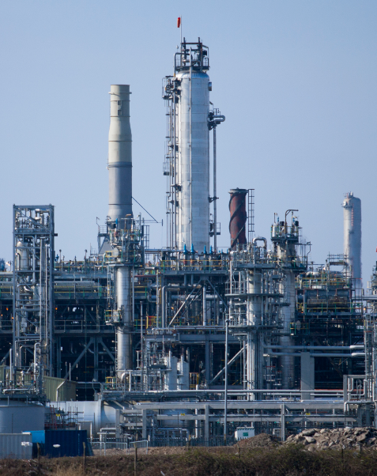
Overview
Organic Chemistry
Carbon compounds as fuels and feedstock
  Crude oil, hydrocarbons and alkanes
  Fractional distillation and petrochemicals
  Properties of hydrocarbons
  Cracking and alkenes
Reactions of alkenes and alcohols (Chemistry only)
  Structure and formulae of alkenes
  Reactions of alkenes
  Alcohols
  Carboxylic acids
Synthetic and naturally occurring polymers (Chemistry only)
Addition polymerisation
Condensation polymerisation (HT only)
Amino acids (HT only)
DNA and other naturally occurring polymers

Slide 3
LearnIT!
KnowIT!
Carbon compounds
as fuels and feedstock
Part 1
  Crude oil, hydrocarbons
  and alkanes

Slide 4
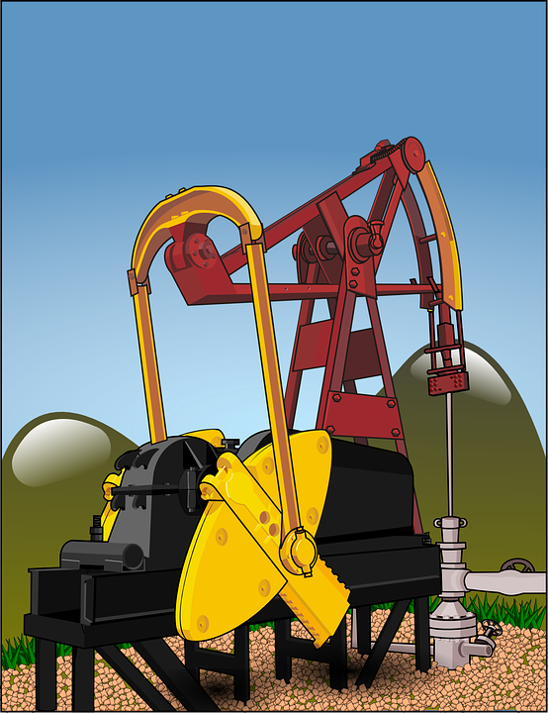
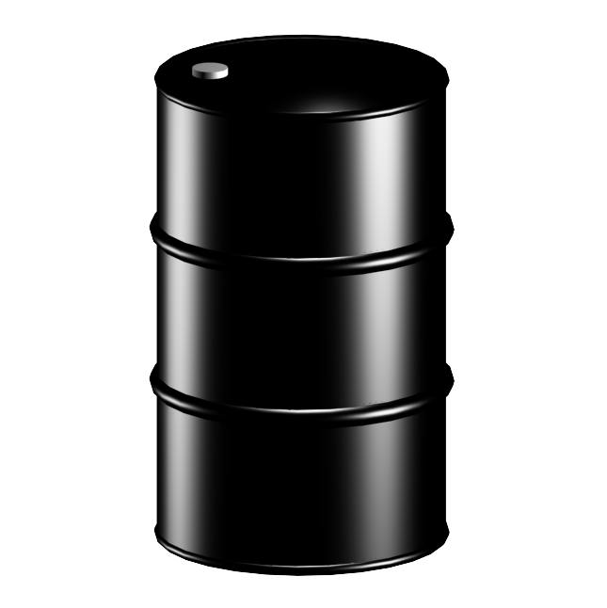
  Crude oil, hydrocarbons and alkanes
Crude oil is a finite resource found in rocks. Crude oil is the remains of an ancient biomass consisting mainly of plankton that was buried in mud.
The two definitions below are very important you must learn both of them
Crude oil is a mixture of a very large number of compounds.
Most of the compounds in crude oil are hydrocarbons, which are molecules made up of hydrogen and carbon only.

Slide 5
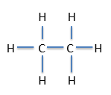
  Crude oil, hydrocarbons and alkanes
Most of the hydrocarbons in crude oil are hydrocarbons called alkanes. The general formula for the homologous series of alkanes is C_{n}H_{2n+2}
The first four members of the alkanes are methane, ethane, propane and butane.
Worked examples
Methane has one carbon atom so it’s formula will be C₁H_{(2x1)+2} this gives CH₄
Ethane has two carbon atoms so it’s formula will be C₂H_{(2x2)+2} this gives C₂H₆
Propane has three carbon atoms so it’s formula will be C₃H_{(2x3)+2} this gives C₃H₈
Butane has four carbon atoms so it’s formula will be C₄H_{(2x4)+2} this gives C₄H₁₀
You will be expected to know the names and formulae of these first four alkanes. You will be expected to calculate the formulae of alkanes with more than four carbons.
These can also be shown as:

Slide 6
QuestionIT!
Carbon compounds
as fuels and feedstock
Part 1
  Crude oil, hydrocarbons
  and alkanes

Slide 7
  Crude oil, hydrocarbons and alkanes– QuestionIT
Crude oil is a finite resource. What does finite mean?
How was crude oil formed?
What is crude oil?
What is the definition of a hydrocarbon?
What is the general formula of the alkanes?
Name the first four members of the alkanes.
What would be the formula of an alkane with nine carbons?
Draw the structural formula of propane.

Slide 8

AnswerIT!
Carbon compounds
as fuels and feedstock
Part 1
  Crude oil, hydrocarbons
  and alkanes

Slide 9
  Crude oil, hydrocarbons and alkanes– QuestionIT
Crude oil is a finite resource. What does finite mean?
  Being used up faster than it is being formed.
How was crude oil formed?
  Remains of an ancient biomass consisting of many plankton that was buried in mud.
What is crude oil?
  Mixture of a very large number of compounds, most of which are hydrocarbons.
What is the definition of a hydrocarbon?
  Compound containing hydrogen and carbon only.

Slide 10
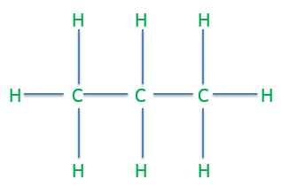
  Crude oil, hydrocarbons and alkanes– QuestionIT
What is the general formula of the alkanes?
  C_{n}H_{2n+2}
Name the first four members of the alkanes.
  Methane, ethane, propane, butane
What would be the formula of an alkane with nine carbons?
  C₉H₂₀
Draw the structural formula of propane.

Slide 11
LearnIT!
KnowIT!
Carbon compounds as fuels and feedstock
Part 2
  Fractional distillation
  and petrochemicals
  Properties of hydrocarbons

Slide 12
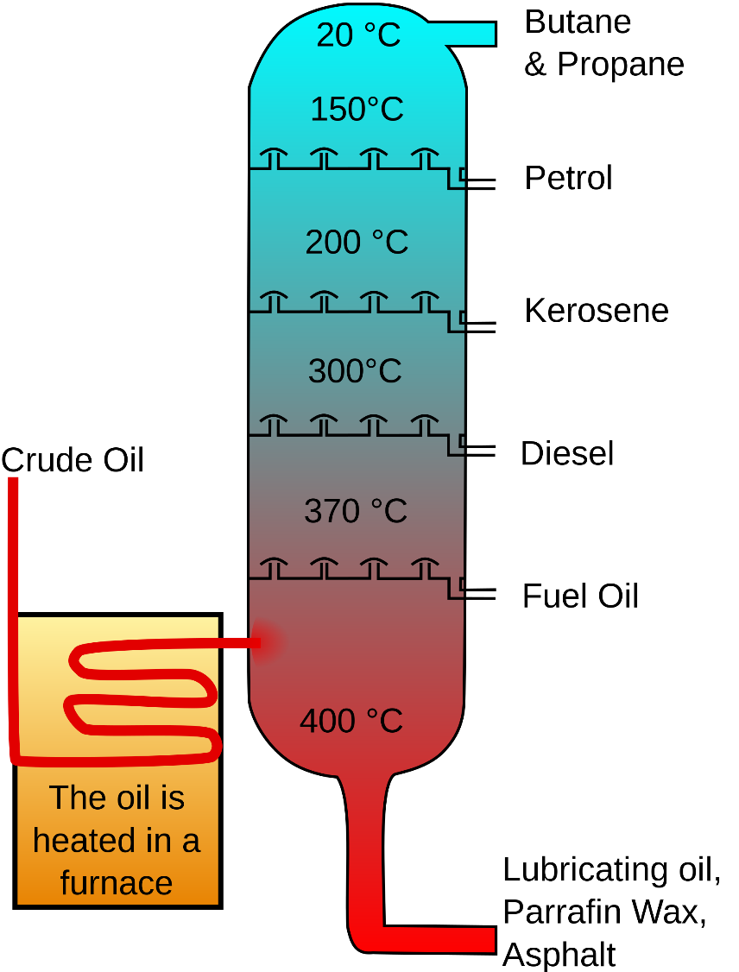
  Fractional distillation and petrochemicals and properties of hydrocarbons
The many hydrocarbons in crude oil may be separated into fractions, each of which contains molecules with a similar number of carbon atoms by fractional distillation
Below is a diagram of a fractional distillation column, learn the order of the fractions on the right hand side
If we look at the diagram on the right all the hydrocarbon molecules in the highest fraction – liquefied petroleum gases will have between 1 and 4 carbons. All the hydrocarbon molecules in petrol will have between 5 and 9 carbons.
Some properties of hydrocarbons depend on the size of their molecules, including:
Boiling point
Viscosity
Flammability
These change with increasing molecular size.
We know that as we go up the fractional distillation column the boiling point and viscosity decrease, the flammability increases.

Slide 13
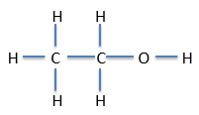
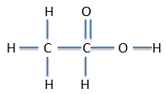
  Fractional distillation and petrochemicals and properties of hydrocarbons
The fractions produced in fractional distillation can be processed to produce fuels e.g. petrol, and feedstock (reactants for further chemical reactions) for the petrochemical industry.
Examples of these useful materials are:
Solvents – nail varnish remover
Lubricants – oil for car engines
Polymers – polythene and polyvinyl chloride PVC
Detergents – washing up liquid
It would be helpful to know all of these useful materials and the examples for the exam.
The vast array of natural and synthetic carbon compounds occur due to the ability of carbon atoms to form families of similar compounds.
Examples of this are ethanol C₂H₅OH and ethanoic acid CH₃COOH. Both contain two carbon atoms, but they make very
different compounds with very different
properties. This would also be the case
for molecules with three or four etc.
carbon molecules.
Ethanol
Ethanoic acid

Slide 14
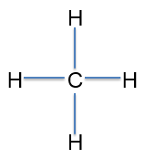
  Fractional distillation and petrochemicals and properties of hydrocarbons
The combustion of hydrocarbon fuels releases energy. During combustion, the carbon and hydrogen in the fuels are oxidised. The complete combustion of a hydrocarbon produces carbon dioxide and water e.g.
Methane + oxygen → carbon dioxide + water
CH₄(g) + 2O₂(g) → CO₂ (g) + H₂O(l)
If we look at methane we can see that to make carbon dioxide and water all of the carbon and hydrogen bonds must break, these will then make carbon and oxygen bonds for carbon dioxide i.e. the carbon is oxidised and hydrogen and oxygen bonds for the water i.e. the hydrogen is oxidised.

Slide 15
  Fractional distillation and petrochemicals and properties of hydrocarbons
The examination boards states that students should be able to write balanced equations for the complete combustion of hydrocarbons with a given formula.
Worked Example
What is the balanced symbol equation for the combustion of C₉H₂₀
C₁₁H₂₄ + 17O₂ → 11CO₂ + 12H₂O
The number in front of CO₂ is always the subscript from the alkane for carbon e.g. 11
The number in front of H₂0 is always half the subscript from the alkane for hydrogen e.g. 12
We then add up the number of oxygen atoms we now have as products e.g. 22 from CO₂ and 12 from H₂O which gives 34, we then put half this number in front of O₂ e.g. 17O₂

Slide 16
QuestionIT!
Carbon compounds
as fuels and feedstock
Part 2
  Fractional distillation, Petrochemicals and Properties of hydrocarbons

Slide 17
  Fractional distillation and petrochemicals and properties of hydrocarbons - QuestionIT
What do we call the many hydrocarbons in crude oil?
How can the hydrocarbons in crude oil be separated out?
The hydrocarbons in crude oil can be processed to produce…
List the following fractions from fractional distillation in order of boiling point, the fraction with the lowest boiling point should be first.
  Kerosene, diesel oil, heavy fuel oil, liquefied petroleum gases, petrol.

Slide 18
  Fractional distillation and petrochemicals and properties of hydrocarbons - QuestionIT
Give three examples of useful materials produced by the petrochemical industry.
How would you describe the boiling point, the viscosity and the flammability of a very large alkane molecule?
Nonane C₉H₂₀ was combusted in oxygen to produce carbon dioxide and water. Write the balanced symbol equation for this reaction.

Slide 19
AnswerIT!
Carbon compounds
as fuels and feedstock
Part 2
  Fractional distillation, Petrochemicals and Properties of hydrocarbons

Slide 20
  Fractional distillation and petrochemicals and properties of hydrocarbons - QuestionIT
What do we call the many hydrocarbons in crude oil?
  Fractions.
How can the hydrocarbons in crude oil be separated out?
  Fractional distillation.
The hydrocarbons in crude oil can be processed to produce…
  Fuels and feedstock.
List the following fractions from fractional distillation in order of boiling point, the fraction with the lowest boiling point should be first.
  Kerosene, diesel oil, heavy fuel oil, liquefied petroleum gases, petrol.
  LPG, petrol, diesel oil, kerosene, heavy fuel oil

Slide 21
  Fractional distillation and petrochemicals and properties of hydrocarbons - QuestionIT
Give three examples of useful materials produced by the petrochemical industry.
  Solvents, lubricants, polymers, detergents.
How would you describe the boiling point, the viscosity and the flammability of a very large alkane molecule?
  High boiling point, high viscosity, low flammability.
Nonane C₉H₂₀ was combusted in oxygen to produce carbon dioxide and water. Write the balanced symbol equation for this reaction.
  C₉H₂₀ + 14O₂ → 9CO₂ + 10H₂O

Slide 22
LearnIT!
KnowIT!
Carbon compounds as fuels and feedstock
Part 3
  Cracking and alkenes

Slide 23
  Cracking and alkenes
Hydrocarbons can be broken down (cracked) to produce smaller more useful molecules.
This is a very important definition.
C₁₀H₂₂ → C₈H₁₈ + C₂H₄
The two products made are both more useful than the starting hydrocarbon, but notice that there are always the same number of carbons and hydrogens on the left hand side of the equation and on the right hand side.
Cracking can be done by various methods including:
Catalytic cracking – the hydrocarbon is heated to a high temperature and a catalyst used
Steam cracking – the hydrocarbon is heated and mixed with steam

Slide 24


  Cracking and alkenes
The products of cracking include alkanes and another type of hydrocarbon called alkenes.
The test for an alkene
Alkenes are more reactive than alkanes and react with orange-brown bromine water to turn it colourless. There is a high demand for fuels with small molecules and so some of the products of cracking are useful as fuels.
→
Orange/brown bromine water
Turns colourless when alkene is added
Alkenes are used to produce polymers and as starting materials for the production of many other chemicals.

Slide 25
QuestionIT!
Carbon compounds as fuels and feedstock
Part 3
  Cracking and alkenes

Slide 26
  Fractional distillation and petrochemicals and properties of hydrocarbons - QuestionIT
Define the term ‘cracking’.
Name two methods of cracking.
What are the conditions needed for cracking?
Which are more reactive: alkanes or alkenes?
What is the test for alkenes?
Complete the following equation for a cracking reaction.
C₁₄H₃₀ C₁₁H₂₄ +

Slide 27
AnswerIT!
Carbon compounds as fuels and feedstock
Part 3
  Cracking and alkenes

Slide 28
  Fractional distillation and petrochemicals and properties of hydrocarbons - QuestionIT
Define the term ‘cracking’.
  Breaking hydrocarbons down to produce smaller, more useful molecules.
Name two methods of cracking.
  Catalytic, steam
What are the conditions needed for cracking?
  High temperature + catalyst
Which are more reactive: alkanes or alkenes?
  Alkenes
What is the test for alkenes?
  Bromine water; orange to colourless
Complete the following equation for a cracking reaction.
C₁₄H₃₀ C₁₁H₂₄ + C₃H₆

Slide 29
LearnIT!
KnowIT!
Reactions of alkenes
(Chemistry only)
Structure and formulae
of alkenes
Reactions of alkenes

Slide 30
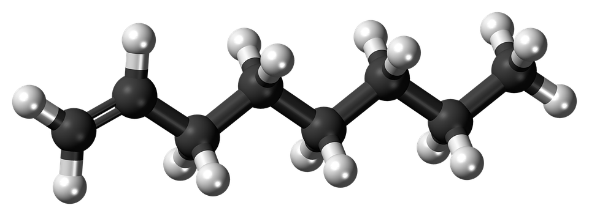
  Structure and formulae of alkenes (Chemistry only)
We already know that alkanes have the general formulae C_{n}H_{2n+2}
Alkenes are hydrocarbons with a double carbon-carbon bond. The general formula for the homologous series of alkenes is C_{n}H_{2n}
The first four members of the alkanes are ethene, propene, butene and pentene.
There is no chemical called methene, as the double bond must be between two carbons. Any hydrocarbon starting with meth- can only have one carbon.

Slide 31
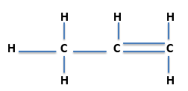
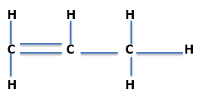
  Structure and formulae of alkenes (Chemistry only)
Worked examples
Ethene has two carbon atoms so it’s formula will be C₂H_{(2x2)} this gives C₂H₄
Propene has three carbon atoms so it’s formula will be C₃H_{(2x3)} this gives C₃H₆
Butene has four carbon atoms so it’s formula will be C₄H_{(2x4)} this gives C₄H₈
Propene has five carbon atoms so it’s formula will be C₅H_{(2x5)} this gives C₅H₁₀
You will be expected to know the names and formulae of these first four alkenes, you will be expected to calculate the formulae of alkenes with more than five carbons
Where the double bond is placed is not important at this stage so for propene we can draw it in one of two ways e.g.
Both are C₃H₆
Or

Slide 32
  Reaction of alkenes (Chemistry only)
Alkenes are hydrocarbons with the functional group . This is the carbon-carbon double bond.
Alkenes react with oxygen in combustion reactions in the same way as other hydrocarbons, but they tend to burn in air with smoky flames because of incomplete combustion.
Alkenes can therefore react as alkanes do e.g.
butene + oxygen → carbon dioxide + water
C₄H₈ + 6O₂ → 4CO₂ + 4H₂O
Incomplete combustion however produces either carbon monoxide CO or carbon C i.e. C₄H₈ + 4O₂ → 4CO + 4H₂O
Or C₄H₈ + 2O₂ → 4C + 4H₂O
Alkenes react with hydrogen, water and the halogens (chlorine, bromine and iodine) by the addition of atoms across the carbon-carbon double bond so that the double bond becomes a single carbon-carbon bond.
Propene + hydrogen → propane
Propene + water → propanol
Propene + chlorine → chloropropane

Slide 33
QuestionIT!
Reactions of alkenes
(Chemistry only)
Structure and formulae
of alkenes
Reactions of alkenes

Slide 34
  Structure, formula and reactions of alkenes (Chemistry only) QuestionIT
What type of bond do all alkenes contain?
What is the general formula for the homologous series of alkenes?
Why are alkenes unsaturated?
What are the first four members of the homologous series of alkenes?
What would be the formula of an alkene that contained 18 hydrogen atoms?

Slide 35
  Structure, formula and reactions of alkenes (Chemistry only) QuestionIT
Draw the structural formula of butane C₄H₈
Write the balanced symbol equation for the incomplete combustion of octane C₈H₁₆ to produce carbon monoxide and water.
What alcohol will be produced when water reacts with butane?
What chemical is produced when bromine reacts with pentene?

Slide 36
AnswerIT!
Reactions of alkenes
(Chemistry only)
Structure and formulae
of alkenes
Reactions of alkenes

Slide 37
  Structure, formula and reactions of alkenes (Chemistry only) QuestionIT
What type of bond do all alkenes contain?
  C=C
What is the general formula for the homologous series of alkenes?
  C_{n}H_{2n}
Why are alkenes unsaturated?
  Contain two fewer hydrogen atoms than the alkane with the same number of carbon atoms.
What are the first four members of the homologous series of alkenes?
  Ethene, propene, butane, pentene.
What would be the formula of an alkene that contained 18 hydrogen atoms?
  C₁₈H₃₆

Slide 38
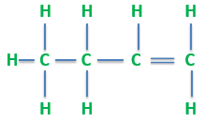
  Structure, formula and reactions of alkenes (Chemistry only) QuestionIT
Draw the structural formula of butane C₄H₈
Write the balanced symbol equation for the incomplete combustion of octane C₈H₁₆ to produce carbon monoxide and water.
C₈H₁₆ + 8O₂ → 8CO + 8H₂O
What alcohol will be produced when water reacts with butane?
  Butanol
What chemical is produced when bromine reacts with pentene?
  Bromopentane
The double bond could be between any two carbons, but make sure each carbon only has 4 bonds.

Slide 39
LearnIT!
KnowIT!
Reactions of alcohols and
Carboxylic acids
(Chemistry only)
Reaction of alcohols
Reactions of carboxylic
acids

Slide 40
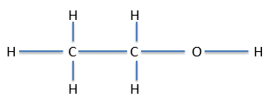
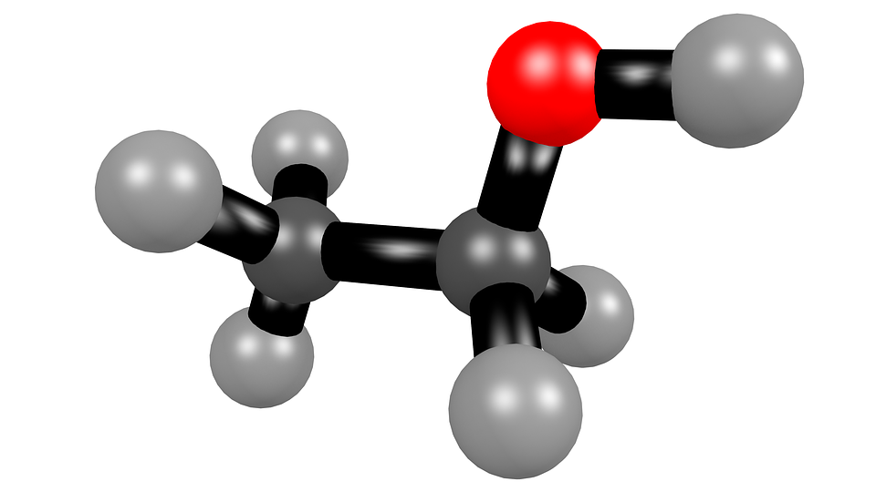
  Reactions of alcohols (Chemistry only)
Alcohols contain the functional group -OH
Methanol has the formula CH₃OH
Ethanol has the formula CH₃CH₂OH or C₂H₅OH
Propanol has the formula CH₃CH₂CH₂OH or C₃H₇OH
Butanol has the formula CH₃CH₂CH₂CH₂OH or C₄H₉OH
An alternative way to show the alcohol structure is:

Slide 41
  Reactions of alcohols (Chemistry only)
Alcohols have a number of important reactions:
When ethanol reacts with sodium, bubbles of hydrogen gas are given off and colourless sodium ethoxide solution is left
Sodium + ethanol → sodium ethoxide + hydrogen
All the alcohols dissolve in water to give colourless solutions with a pH of 7.
Alcohols can react with an oxidising reagent to make the carboxylic acid e.g. ethanol will oxidise to make ethanoic acid.
Alcohols also undergo combustion reactions with oxygen e.g.
Propanol + oxygen → carbon dioxide + water
C₃H₇OH + 5O₂ → 3CO₂ + 4H₂0
Aqueous solutions of ethanol are produced when sugar solutions are fermented using yeast.
The conditions needed for fermentation to happen are:
A temperature between 25^{O}C and 45^{O}C
Water but no oxygen

Slide 42
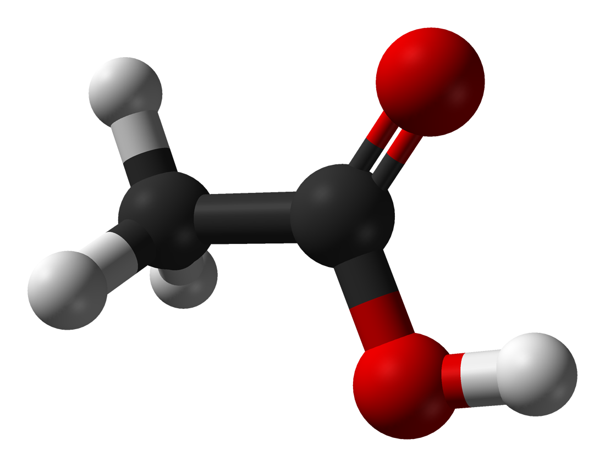
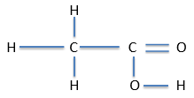
  Reactions of carboxylic acids (Chemistry only)
Carboxylic acids have the functional group -COOH
Methanoic acid has the formula CHOOH
Ethanoic acid has the formula CH₃COOH
Propanoic acid has the formula C₂H₅COOH
Butanoic acid has the formula C₃H₇COOH
An alternative way to show the carboxylic acid structure is:

Slide 43
  Reactions of carboxylic acids (Chemistry only)
Carboxylic acids have a number of important reactions:
When we react carboxylic acids with a metal carbonate a salt, carbon dioxide and water are produced e.g.
Sodium carbonate + propanoic acid → sodium propanoate + carbon dioxide + water
Carboxylic acids with five or less carbons dissolve in water. Carboxylic acids with more than five carbons in them are less soluble.
Carboxylic acids will react with alcohols to make an ester and water, an acid catalyst is needed (ethyl ethanoate is the ester below)
Ethanoic acid + ethanol → ethyl ethanoate + water
(HT only)
Carboxylic acids are described as weak acids as they are only partially ionised, therefore they give off relatively few hydrogen ions in comparison to strong acids and have a higher pH than strong acids.

Slide 44
QuestionIT!
Reactions of alcohols and
Carboxylic acids
(Chemistry only)
Reaction of alcohols
Reactions of carboxylic
acids

Slide 45
  Reactions of alcohols and carboxylic acids (Chemistry only)QuestionIT
Name and give the formulae of the first three alcohols.
What is the functional group that all alcohols contain?
What are the conditions needed for sugar to ferment into alcohol?
Write a word equation for the reaction between ethanol and oxygen.
Write a word equation for the reaction between ethanol and sodium.

Slide 46
  Reactions of alcohols and carboxylic acids (Chemistry only)QuestionIT
What is the functional group that all carboxylic acids contain?
Name the first four members of the homologous series of carboxylic acids.
Name and give the formula of the carboxylic acid that contains four carbon atoms.
Draw the structural formula of propanoic acid.
Which two chemicals are made when an alcohol and a carboxylic acid are reacted together?

Slide 47
AnswerIT!
Reactions of alcohols and
Carboxylic acids
(Chemistry only)
Reaction of alcohols
Reactions of carboxylic
acids

Slide 48
  Reactions of alcohols and carboxylic acids (Chemistry only)QuestionIT
Name and give the formulae of the first three alcohols.
  methanol CH₃OH, ethanol C₂H₅OH, propanol C₃H₇OH
What is the functional group that all alcohols contain?
  -OH
What are the conditions needed for sugar to ferment into alcohol?
  No oxygen, temperature between 25^{O}C and 45 ^{O}C, water and yeast.
Write a word equation for the reaction between ethanol and oxygen.
  Ethanol + oxygen → carbon dioxide and water
Write a word equation for the reaction between ethanol and sodium.
  Ethanol + sodium → sodium ethoxide + hydrogen

Slide 49
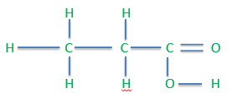
  Reactions of alcohols and carboxylic acids (Chemistry only)QuestionIT
What is the functional group that all carboxylic acids contain?
  -COOH
Name the first four members of the homologous series of carboxylic acids.
  Methanoic acid, ethanoic acid, propanoic acid, butanoic acid.
Name and give the formula of the carboxylic acid that contains four carbon atoms.
  Butanoic acid.
Draw the structural formula of propanoic acid.
Which two chemicals are made when an alcohol and a carboxylic acid are reacted together?
  Ester and water

Slide 50
LearnIT!
KnowIT!
Synthetic and naturally
Occurring polymers
(Chemistry only)
Addition polymerisation
condensation polymerisation
(HT only)
Amino acids (HT only)

Slide 51
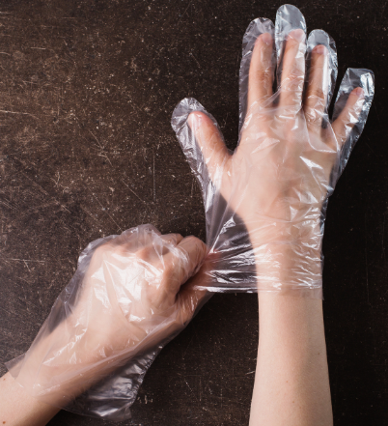
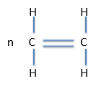
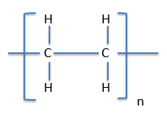
  Addition polymerisation (Chemistry only)
Alkenes can be used to make polymers such as poly(ethane) and poly(propene) by addition polymerisation.
In addition polymerisation reactions, many small molecules (monomers) join together to form very large molecules (polymers).
Polythene has many uses.
An example of this is
One of the double bonds in the monomer breaks to form a single bond with other monomers. This leads to a very long polymer.
→
In addition polymers the repeating unit, n, has the same atoms as the monomer because no other molecule is formed in the reaction.
You must be able to move from the monomer to the polymer or polymer to the monomer

Slide 52
  Condensation, polymerisation and amino acids (Chemistry HT only)
Condensation polymerisation involves monomers with two functional groups. When these types of monomers react they join together, usually losing small molecules such as water, and so the reactions are called condensation reactions.
The simplest polymers are produced from two different monomers with two of the same functional groups on each monomer.
An example of this is:
Ethane diol (this is ethane with two –di – alcohol – ol groups at either end)
HO – CH₂ – CH₂ – OH or HO - - OH
And
Hexanedioic acid (this is hexane with two carboxylic acid groups at the end)
HOOC - CH₂ - CH₂ - CH₂ - CH₂ – COOH or HOOC - - COOH
Polymerise to produce a polyester
n HO - -OH + n HOOC - - COOH → OOC COO + 2nH₂O
n

Slide 53
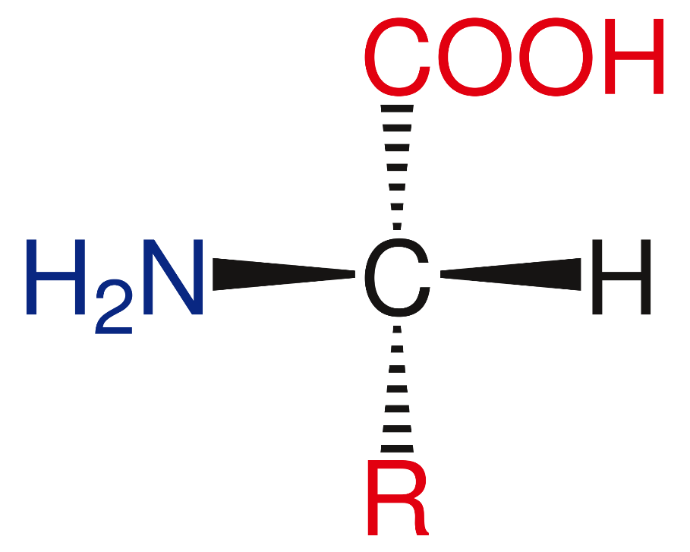
  Condensation, polymerisation and amino acids (Chemistry HT only)
Amino acids have two different functional groups in a molecule. Amino acids react by condensation polymerisation to produce polypeptides.
e.g. glycerine is H₂NCH₂COOH and polymerises to produce the polypeptide (-HNCH₂COO-)n and n H₂O
Different amino acids can be combined in the same chain to produce proteins.

Slide 54
QuestionIT!
Synthetic and naturally
Occurring polymers
(Chemistry only)
Addition polymerisation
condensation polymerisation
(HT only)
Amino acids (HT only)

Slide 55
  Addition and condensation polymerisation and amino acids (Chemistry HT only)QuestionIT
What is polymerisation?
What type of polymerisation joins alkenes together to make polymers?
What is the monomer called which forms the polymer poly(ethene)?
What type of polymer would butene make and what would it be called?

Slide 56
  Addition and condensation polymerisation and amino acids (Chemistry HT only)QuestionIT
HT ONLY - What happens during condensation polymerisation?
HT ONLY - Explain how amino acids polymerise to form a polypeptide.
HT ONLY - Name and give the formula of one amino acid that polymerises in this way.

Slide 57
AnswerIT!
Synthetic and naturally
Occurring polymers
(Chemistry only)
Addition polymerisation
condensation polymerisation
(HT only)
Amino acids (HT only)

Slide 58
  Addition and condensation polymerisation and amino acids (Chemistry HT only)QuestionIT
What is polymerisation?
  Many monomers join to form a polymer.
What type of polymerisation joins alkenes together to make polymers?
  Addition polymerisation.
What is the monomer called which forms the polymer poly(ethene)?
  Ethene.
What type of polymer would butene make and what would it be called?
  Addition polymer called poly(butene).

Slide 59
  Addition and condensation polymerisation and amino acids (Chemistry HT only)QuestionIT
HT ONLY - What happens during condensation polymerisation?
  Monomers with two functional groups; small molecules such as water are lost through ‘condensation’.
HT ONLY - Explain how amino acids polymerise to form a polypeptide.
  Condensation polymerisation. Two functional groups, water lost by condensation.
HT ONLY - Name and give the formula of one amino acid that polymerises in this way.
  glycerine – H₂NCH₂COOH

Slide 60
LearnIT!
KnowIT!
Synthetic and naturally
Occurring polymers
(Chemistry only)
DNA and other naturally occurring polymers

Slide 61

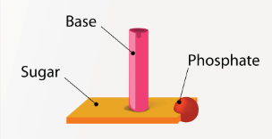
  DNA and other naturally occurring polymers
DNA (deoxyribonucleic acid) is a large molecule essential for life. DNA encodes genetic instructions for the development and functioning of living organisms and viruses.
Most DNA molecules are two polymer chains, made from four different monomers called nucleotides, in the form of a double helix.
polymer chain
We can show the double helix structure in the following way
Each nucleotide contains a base, a phosphate and a deoxyribose sugar.
There are four different bases: guanine, cytosine, thymine or adenine. The nucleotide depends upon the base it contains.
There are other naturally occurring polymers:
Starch and cellulose are both made from the monomer glucose
Proteins are made from the monomer amino acids

Slide 62
QuestionIT!
Synthetic and naturally
Occurring polymers
(Chemistry only)
DNA and other naturally occurring polymers

Slide 63
DNA and other naturally occurring polymers QuestionIT
What is DNA?
What does DNA do?
Describe the structure of DNA.
What are the monomers that make up DNA?
What three substances make up these monomers?
Name three other naturally occurring polymers important for life.
Name the monomer for protein, starch and cellulose.

Slide 64
AnswerIT!
Synthetic and naturally
Occurring polymers
(Chemistry only)
DNA and other naturally occurring polymers

Slide 65
DNA and other naturally occurring polymers QuestionIT
What is DNA?
  Large polymer essential for life; deoxyribonucleic acid.
What does DNA do?
  Encodes genetic instructions for the development and functioning of living organisms and viruses.
Describe the structure of DNA.
  Two polymer chains, double helix.
What are the monomers that make up DNA?
  Nucleotides.
What three substances make up these monomers?
  Base, phosphate, deoxyribose sugar.
Name three other naturally occurring polymers important for life.
  Proteins, starch, cellulose.
Name the monomer for protein starch and cellulose.
  Proteins – amino acids; starch and cellulose – glucose.

